Slide 1
Advanced Data Analytics: Multiple Views
Ian Nabney
ian.nabney@bristol.ac.uk

Slide 2
Overview
Reading: Chapter 12 of Munzner
Understand the design choices to show information across multiple views
Understand the key question of coordination across multiple views
Able to apply appropriate choices to design challenges

Slide 3
Splitting the display
One option for showing views is juxtapose them side by side, leading to many choices of how to coordinate these views with each other.
The other option is to superimpose the views as layers on top of each other. When the views show different data, a set of choices covers how to partition data across multiple views.
The main design choices for juxtaposed views cover how to coordinate them: which visual encoding channels are shared between them, how much of the data is shared between them, and whether the navigation is synchronized.
Other juxtaposition choices are when to show each view and how to arrange them.
The design choices for partitioning are how many regions to use, how to divide the data up into regions, the order in which attributes are used to split, and when to stop.
The design choices for how to superimpose include how elements are partitioned between layers, how many layers to use, how to distinguish them from each other, and whether the layers are static or dynamically constructed.

Slide 4
Why use multiple views?
Multiple views juxtaposed side by side are spread out in space, an alternative to a changing view where the information presented to the user is spread out over time.
Comparing two views that are simultaneously visible is relatively easy, because we can move our eyes back and forth between them to compare their states.
In contrast, for a changing view, comparing its current state to its previous state requires users to consult their working memory.
The significant cost for juxtaposed views is the display area required to show these multiple windows side by side. Display area is a scarce external resource.
Superimposing layers does not require more screen space. Visual layering is a way to control visual clutter in complex visual encodings, leading to a less cluttered view than a single view without any layers.
One limitation of superimposing is that creating visually distinguishable layers imposes serious constraints on visual encoding choices: two is very feasible and three is possible with care, but more is difficult.

Slide 5
Coordination: encoding shared or different?
The most common method for linking views together is to use a visual channel in the same way across the multiple views.
The design choice of shared encoding views means that all channels are handled the same way for an identical visual encoding. The design choice of multiform views means that some, but not necessarily all, aspects of the visual encoding differ between the two views. In a multiform system two views might have different spatial layouts but the same colour coding. Some forms of linking don’t necessarily require interactivity and can be done with completely static views.
Interactivity unleashes the full power of linked views. One of the most common forms of linking is linked highlighting, where items that are interactively selected in one view are immediately highlighted in all other views using in the same highlight colour. The central benefit of the linked highlighting idiom is in seeing how a region that is contiguous in one view is distributed within another.

Slide 6
Rationale for multiform views
There are strong limits on the number of attributes that can be shown simultaneously in a single view without introducing too much visual clutter. Although simple abstract tasks can often be fully supported by a single view of a specific dataset, more complex ones often cannot.
With multiple views as opposed to a single view, each view does not have to show all of the attributes; they can each show only a subset of the attributes, avoiding visual clutter.
Even if two views show exactly the same set of attributes, the visual channels used to encode can differ. The most important channel change is what spatial position encodes; this most salient channel dominates our use of the view and strongly affects what tasks it best supports. Multiform views can thus exploit the strengths of multiple visual encodings.

Slide 7
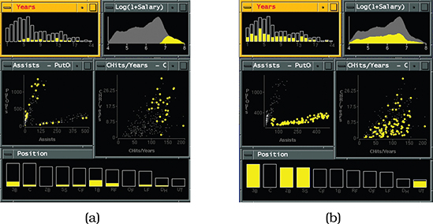
Example: exploratory data visualiser (EDV)
The EDV system features the idiom of linked highlighting between views, here a baseball statistics dataset with linked bar charts, scatterplots, and a histogram.
In Figure (a), the user has selected players with high salaries in the smoothed histogram view on the upper right.
In Figure (b), the user has selected players in the bottom group in the Assists-PutOut chart

Slide 8
Coordination: sharing data
There are three alternatives: with shared data, both views could each show all of the data; with overview–detail, one view could show a subset of what is in the other, or with small multiples, the views could show different partitions of the dataset into disjoint pieces.
Showing all of the data in each view is common with multiform systems, where the encoding differs between the views.
With overview–detail, one of the views shows information about the entire dataset to provide an overview of everything. One or more additional views show more detailed information about a subset of the data that is selected by the viewer from the overview.

Slide 9
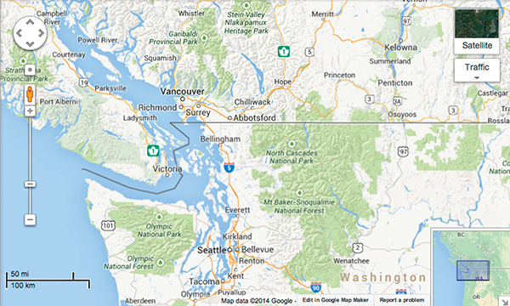
Example: bird’s eye maps
A small rectangle within the overview shows the region viewable within the detail view.
Usually, linkage is unidirectional, where position and size of the rectangle in the overview updates as the user pans and zooms within the large detail view.
With bidirectionally linked views, the rectangle can also be moved within the small view to update the region shown in the large one.

Slide 10
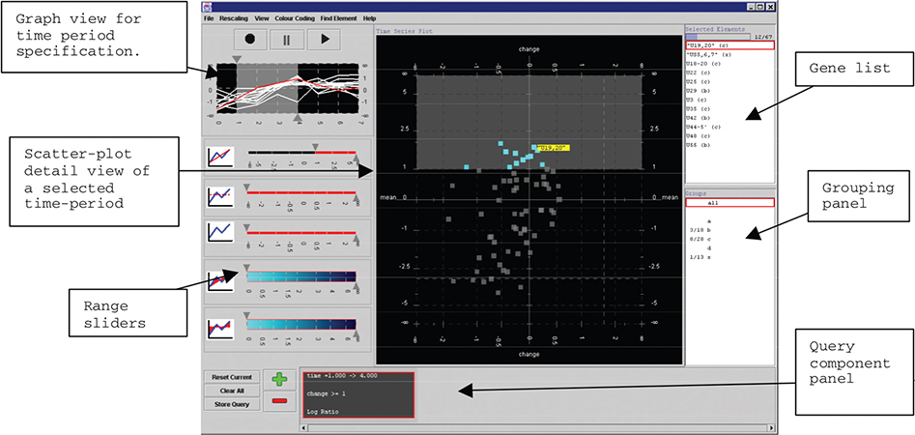
Example: multiform overview-detail microarrays
Tool to support the visual exploration of microarray time-series data by biologists
Five tasks: finding genes that were on or off across the whole time period, finding genes whose values rose or fell over a specified time window, finding genes with similar time-series patterns, relating all these sets to known functional groups of genes, and exporting the results for use within other tools

Slide 11
Small multiples
Small multiples show a different partition of the dataset in each view.
The shared visual encoding means that the views have a common reference frame so that comparison of spatial position between them is directly meaningful. Small multiples are often aligned into a list or matrix to support comparison with the highest precision.
The choice of small-multiple views is the converse of multiform views, since the encoding is identical but the data differs.
The weakness of small multiples is the screen real estate required to show all of these views simultaneously. The operational limit with current displays of around one million pixels is a few dozen views with several hundred elements in each view.
The strength of the small-multiple views is in making different partitions of the dataset simultaneously visible side by side, allowing the user to glance quickly between them with minimal interaction cost and memory load.
Small multiples are often used as an alternative to animations, where all frames are visible simultaneously rather than shown one by one. Animation imposes a massive memory load when the amount of change between each frame is complex and distributed spatially between many points in the scene.

Slide 12
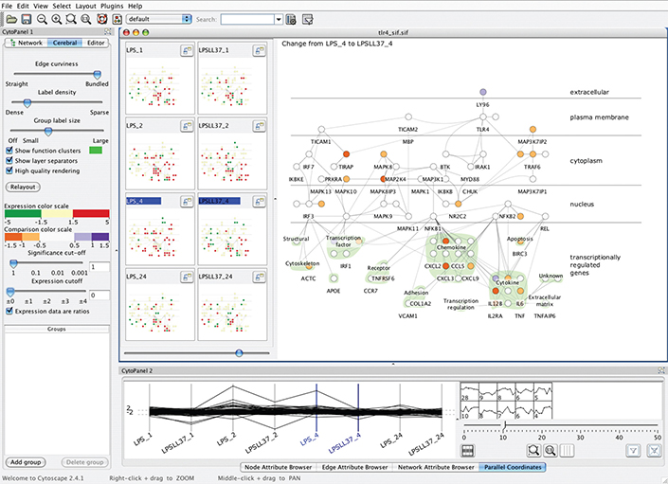
Example: Cerebral
The dataset is from the bioinformatics domain, a multidimensional table with the two keys of genes and experimental condition and the value attribute of microarray measurements of gene activity for the condition.

Slide 13
Example: Improvise
The Improvise system supports complex combinations of different view types.
The demonstration shows a vis of census data that uses many views.
In addition to geographic information, the demographic information for each county includes population, density, genders, median age, percentage change since 1990, and proportions of major ethnic groups.
The system is multiform with geographic, scatterplot, parallel coordinate, tabular, and matrix views. These multiform views all share the same bivariate sequential–sequential colour encoding, documented with a legend in the bottom middle.
A set of small-multiple views appears in the lower left in the form of a scatterplot matrix, where each scatterplot shows a different pair of attributes.
All of the views are linked by highlighting: the blue selected items are close together in some views and spread out in others. A set of small-multiple reorderable list views result from partitioning the data by attribute. The list views allow direct sorting by and selection within an attribute of interest.
The map in the upper left view is a small overview, with linked navigation to the large geographic detail view in the top middle.

Slide 14
Partitioning
Design choice of how to partition a multivariate dataset into meaningful groups has major implications for what kind of patterns are visible to the user. This choice encodes association using spatial proximity, a highly ranked channel.
how many splits to carry out: splitting could continue through as many attributes as are available until the simplest case of one region per item has been reached and it can be encoded with a single mark, or it could stop at a higher level where there is more complex structure within each region;
order in which attributes are used to split;
how many views to use; while this decision is often data driven, it could be determined in advance.
A partitioning attribute is typically a categorical variable that has only a limited number of unique values. It may be a key variable, but does not have to be.
To connect partitioning to visual encoding choices, each partitioned group can be placed within a region of space.
These regions then need to be ordered, and often aligned. For example, after space is subdivided into regions, they can be aligned and ordered within a 1D list, or 2D matrix.
Recursive subdivision allows these regions to nest inside each other; these nested regions may be arranged using the same choices as their enclosing regions or different choices.

Slide 15
Views and glyphs
Large, stand-alone, highly detailed regions are called views, and small, nested, schematic regions are called glyphs.
For example, a single bar chart that is 800 pixels wide and 400 pixels high, with axes that have labels and tick marks, confidence intervals shown for each bar, and both a legend and a title would usually be called a view.
If there is a set of bar charts that are each 50 by 25 pixels, each with a few schematic bars and two thin unlabelled lines to depict the axes, where each appears within a geographic region on a map, each chart might be called a glyph.

Slide 16
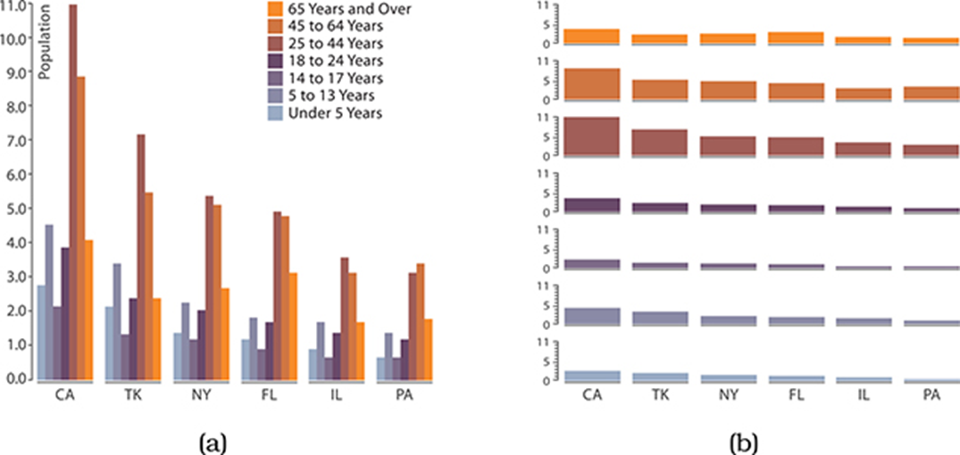
List alignment
In a grouped bar chart, a multibar glyph is drawn within each region where a single mark would be drawn in a standard bar chart. In Figure (a), the regions are the states, and the bars within each glyph show demographic category.
The small-multiple design choice simply shows several standard bar charts, one in each view. In Figure (b), each view shows a demographic category, with the states spread along each standard bar chart axis. The grouped bar chart facilitates comparison between the attributes, whereas the small multiple bar charts facilitate comparison within a single attribute.

Slide 17
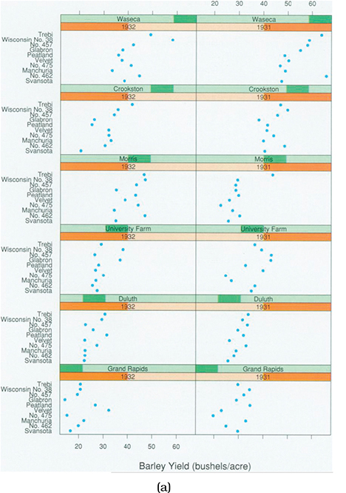
Matrix alignment
Trellis system partitioning a multivariate dataset into multiple views and ordering them within a 2D matrix alignment.
Figure shows a dataset of barley yields with dot charts. Three categorical attributes act as keys.
The site attribute has six unique levels, the locations where the barley was grown.
The variety attribute for the type of barley grown has ten levels.
The year attribute has only two levels.
The dataset also has a fourth quantitative attribute, the yield.
The plots of the Morris site in the third row do not match up with the others, suggesting that perhaps the years had been switched.

Slide 18
Superimposing layers
The superimpose family of design choices pertains to combining multiple layers together by stacking them directly on top of each other in a single composite view.
All of the drawings have the same horizontal and vertical extent and are blended together as if the single drawings are completely transparent where no marks exist.
The design choices for how to superimpose views include:
How many layers are used?
How are the layers visually distinguished from each other?
Is there a small static set of layers that do not change, or are the layers constructed dynamically in response to user selection?

Slide 19
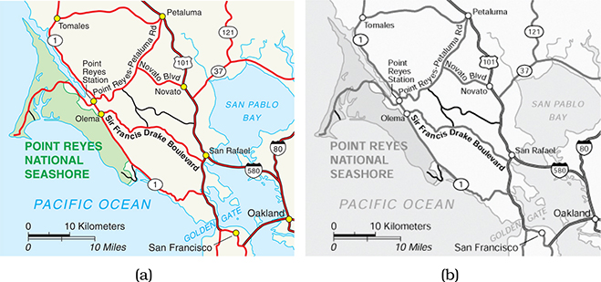
Static layers
In static layers all of the layers are displayed simultaneously; the user can choose which to focus on with the selective direction of visual attention.
This approach is frequently used for maps.
Area marks form a background layer, with three different unsaturated colours distinguishing water, parks, and other land.
Line marks form a foreground layer for the road network, with main roads encoded by wide lines in a fully saturated red colour and small roads with thinner black lines.
This layering works well because of the luminance contrast between the elements on different layers, as can be seen from Figure (b).

Slide 20
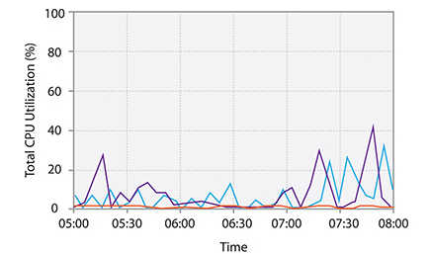
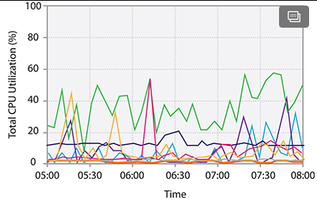
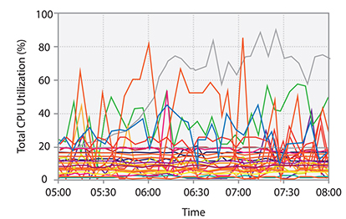
Example: superimposed line charts
This simple superimposition works well because the only mark is a thin line that is mostly disjoint with the other marks.
The amount of occlusion is very small with only three lines.
This idiom is still usable with even nearly one dozen items superimposed.
However, this approach does not scale to many dozens or hundreds of items.

Slide 21
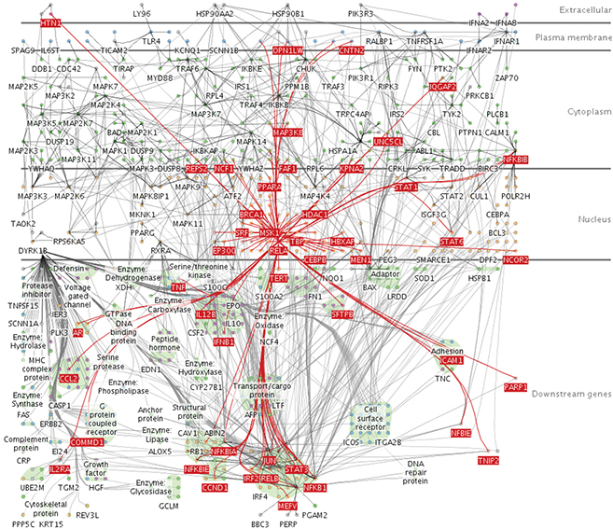
Dynamic layers
With dynamic layers, a layer with different salience than the rest of the view is constructed interactively, typically in response to user selection.
The Cerebral system, shown also on slide 12, uses the design choice of dynamic layering. The Figure shows the dynamic creation of a foreground layer that updates constantly as the user moves the cursor. When the cursor is directly over a node, the foreground layer shows its one-hop neighbourhood: this is visually emphasized with a fully saturated red to create a foreground layer that is visually distinct from the background layer, which has only low-saturation colours. The foreground marks also have larger linewidth.

Slide 22
Summary
Complex datasets often require multiple views to enable the user to carry out tasks
We can juxtapose multiple views but need to consider how they are coordinated
There is also the alternative of partitioning the data (often by attributes)
Layers can be superimposed – but to a much more limited extent

